Slide 1

An Adventure with the Ensemble Kalman Filter
Mario Shontz

Slide 2
Objective
To go through the full process of obtaining real-world data, preprocessing it, preparing it for use, and implementing an actual Data Assimilation method.

Slide 3
Problem Setup
GPS Localization is imperfect and can be especially inaccurate under conditions that increase interference.
The accuracy of road navigation is somewhat illusory – given movement patterns it can be quite easy to determine which road a car is heading down, which makes up for the inaccuracies of GPS in this scenario.
For GPS navigation for walking directions, pure accuracy is much more important.

Slide 4
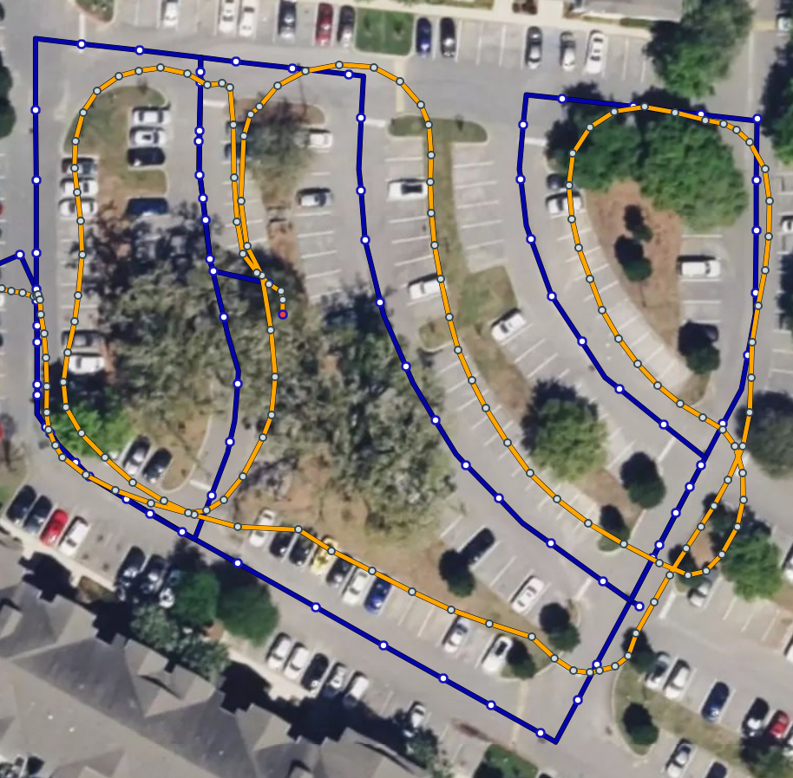
A proof of concept
Use the Ensemble Kalman filter to assimilate the data of two GPS tracking devices as a person walks around an area. This is a common scenario when someone has a wearable device and a phone.
The steps are as follows:
Record GPS Data
Preprocess
Create and run the EnKF
I will go through each of these steps

Slide 5
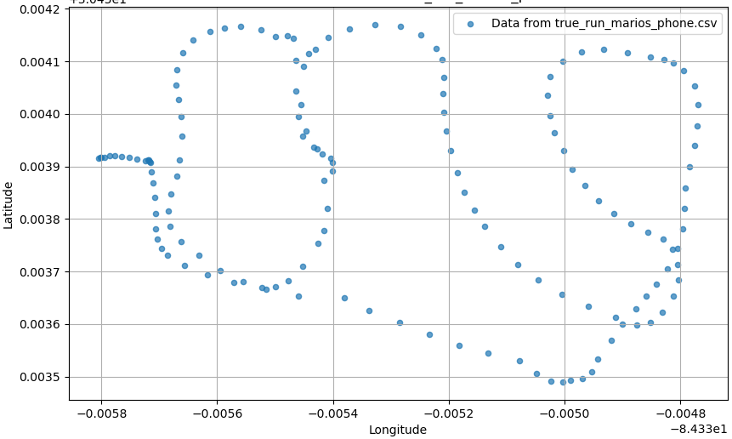
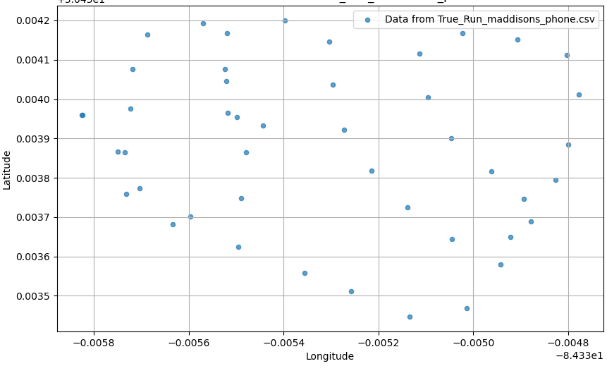
Recording GPS
I downloaded an app, recorded my walk on two devices, and exported the data to csv.
I also recorded my position without moving for some time to establish a baseline variance (R matrix) for both devices.

Slide 6
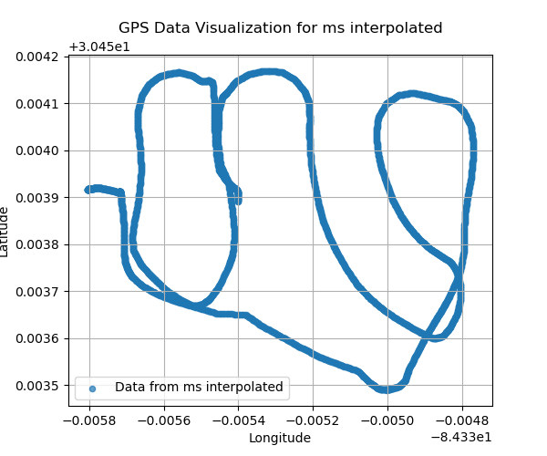
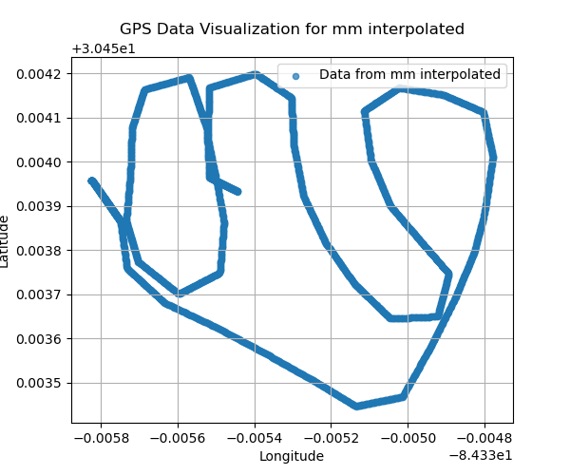
Preprocessing
Cleaned route data and removed unnecessary columns
Interpolated the routes to allow for synchronization of observation times.
Created the R matrix by finding the variance and covariances for each sensor using the stationary data. Included covariances on the off-diagonals as I believed in this case the errors in Latitude and Longitude would be correlated.

Slide 7
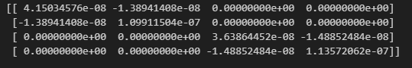
Formulating EnKF Inputs
R – Matrix: The latitude
and longitude errors must be correlated given
that I am using satellite data which is affected by satellite position and interference, which both affect the longitude and latitude readings. included covariances on the off-diagonals for each sensor.
Q – Initialized with a diagonally matrix of 0.1s
H – Maps the observations (4x1) to the state (2x1), so I used [[1,0],[0,1],[1,0],[0,1]]

Slide 8
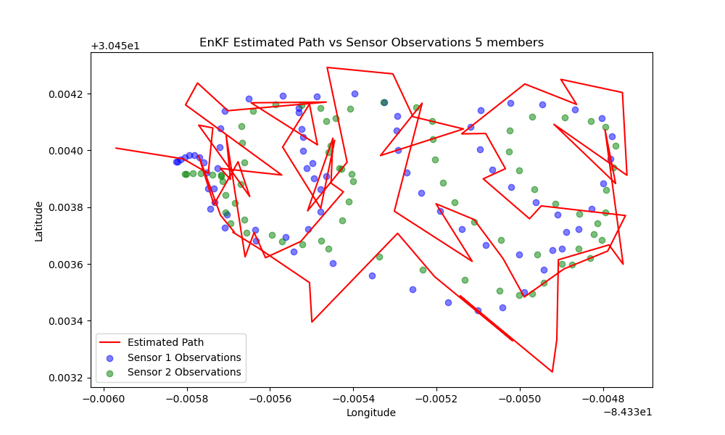
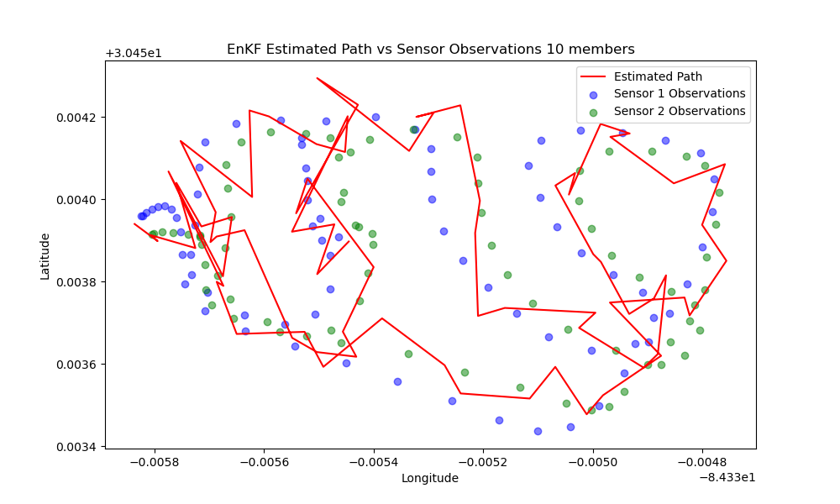
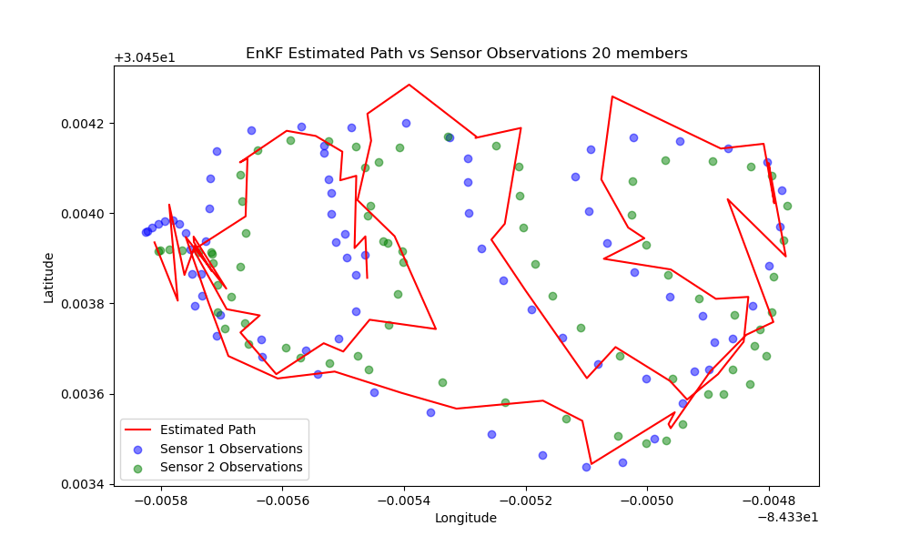
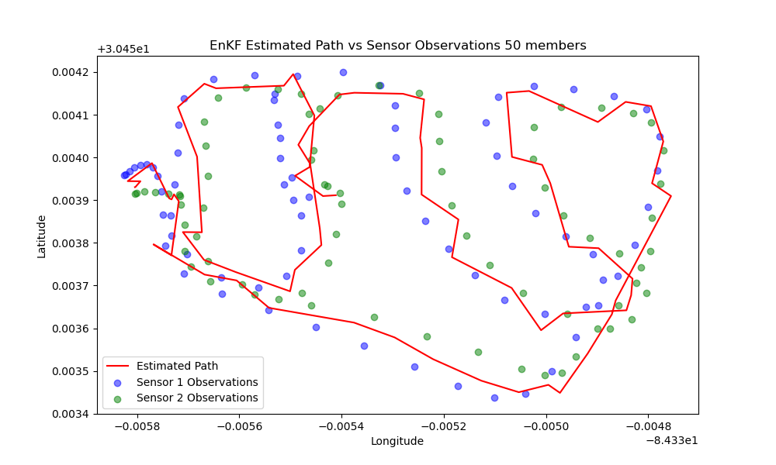
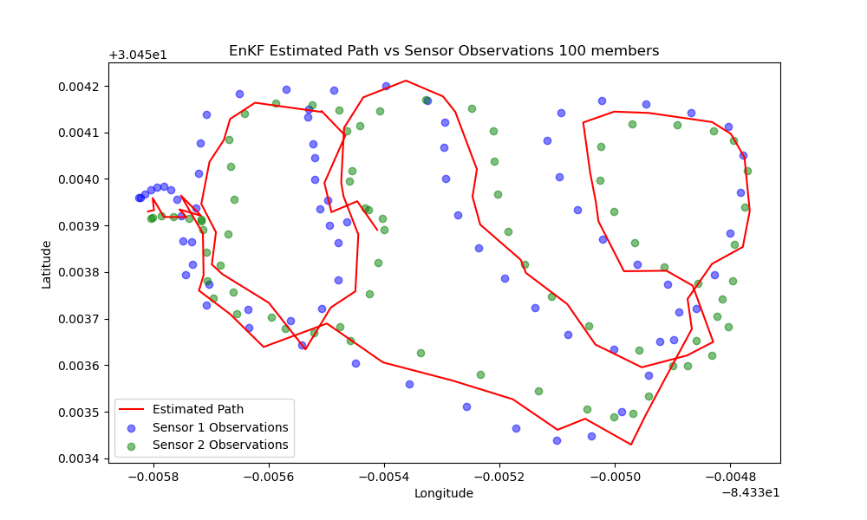
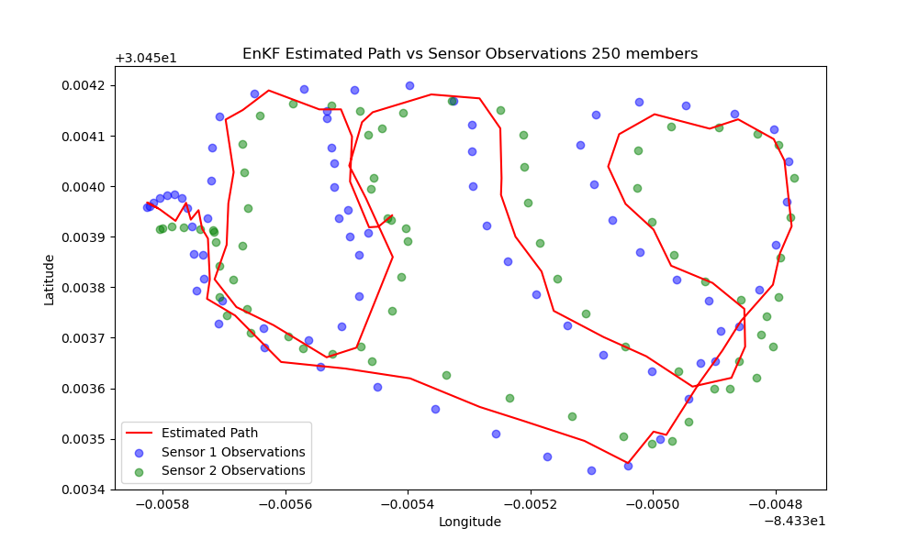
Results

Slide 9
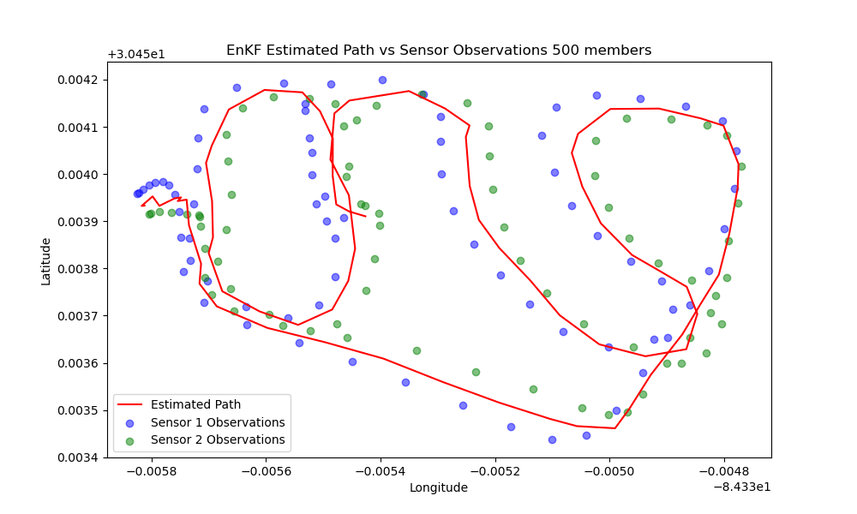

Slide 10
Conclusions
While this was a toy example, the EnKF seems to be a viable tool for GPS navigation, particularly when paired with other data sources such as local sensors and more context.

